Slide 1
Methods 1 Lab
Lecture 11

Slide 2
Kappa Statistic

Slide 3
Kappa Statistic
Measure of agreement between two raters
How to interpret the kappa statistic?
Based on the author (Rosner) of your textbook:
k >0.75: excellent reproducibility
0.4 < k < 0.75: good reproducibility
k <0.4: marginal reproducibility

Slide 4
Kappa Statistic - Exercise
Example: Two blind evaluators administered the AHA to the children in your research study. You want to quantify the level of agreement between evaluators on whether or not the child had an average AHA score.
 |  | Rater 2
 |  | Below Avg | Above Avg | Total
Rater 1 | Below Avg | 9 | 2 | 11
 | Above Avg | 0 | 9 | 9
 | Total | 9 | 11 | 20

Slide 5
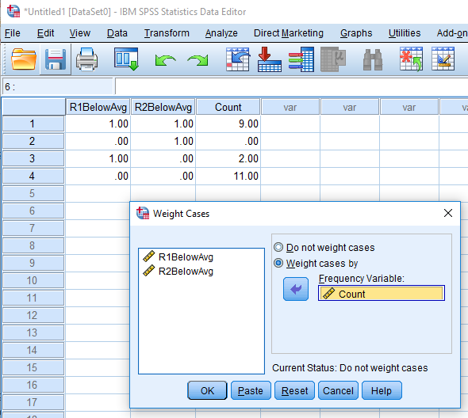
Kappa Statistic - Exercise
Enter the data into SPSS and weight the data by ‘Count’
Data
Weight Cases
‘Weight Cases By’ -> Count

Slide 6
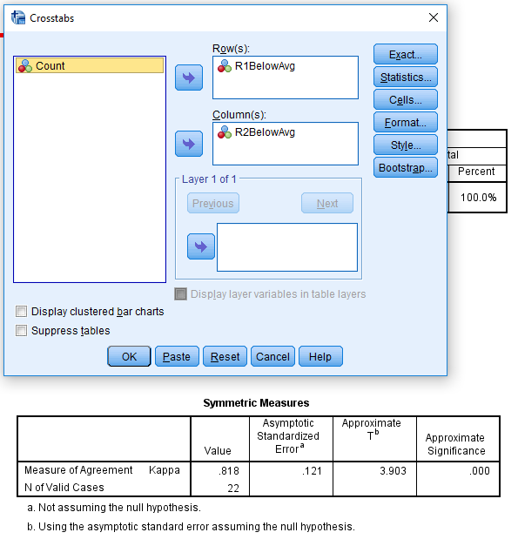
Kappa Statistic - Exercise
Calculate the kappa statistic
Analyze
Descriptive Statistics
Crosstabs
‘Row(s)’ -> R1BelowAvg
‘Column(s)’ -> R2BelowAvg
‘Statistics’
‘Kappa’

Slide 7
Analysis of Variance (ANOVA) and Multiple Comparisons

Slide 8
Multiple Comparisons
If we reject the ANOVA null hypothesis , and we need to determine which group means differ
We can determine which group means differ by doing multiple comparisons
Popular multiple comparison methods
Bonferroni
Tukey
Scheffe

Slide 9
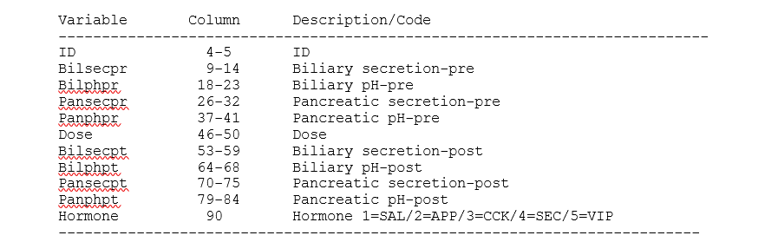
ANOVA and Multiple Comparison- Exercise
Hormone data from the course textbook (Rosner, 7th edition)
Hormone study conducted with chickens
Five treatment groups
One saline group
Four hormone groups

Slide 10
ANOVA and Multiple Comparison- Exercise
1. Using the Hormone.dat file, conduct ANOVA to determine if there is a difference in biliary-secretion post levels (variable name: bilsecpt) among the treatment groups
2. Use a Bonferonni approach to conduct all pairwise comparisons of the treatment groups for the biliary-secretion post levels

Slide 11
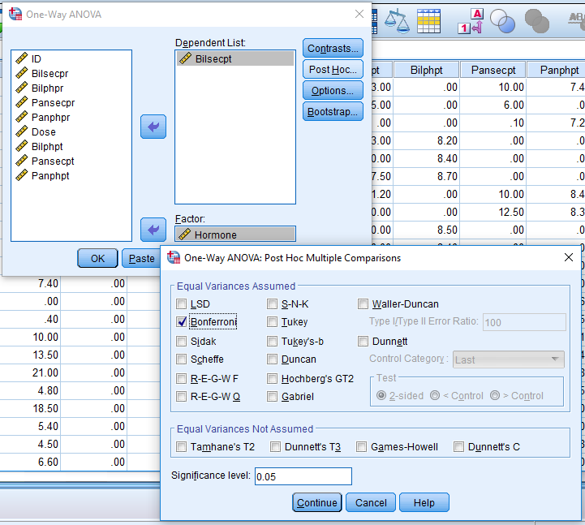
ANOVA and Multiple Comparison- Exercise
ANOVA Steps
Analyze
Compare Means
One-Way ANOVA
Dependent -> bilsecpt
Factor -> hormone
‘Post-Hoc’ -> Bonferonni

Slide 12
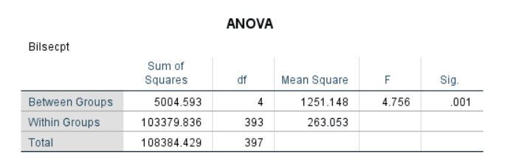
ANOVA and Multiple Comparison- Exercise
Based on the p-value, what should we conclude about the treatment groups?

Slide 13
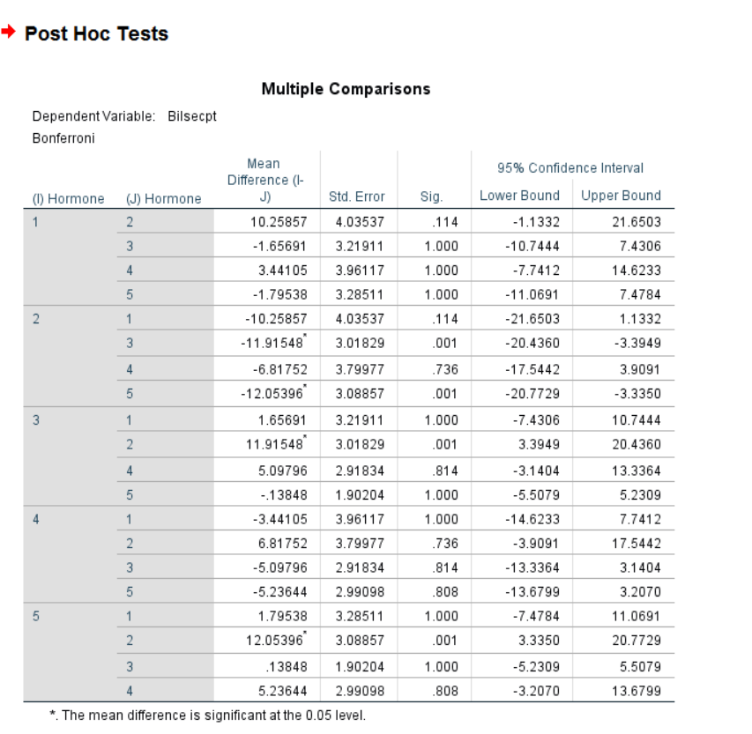
ANOVA and Multiple Comparison- Exercise

